Slide 1

DAYANANDA SAGAR COLLEGE OF ENGINEERING DEPARTMENT OF COMPUTER SCIENCE AND ENGINEERING
DEPARTMENT OF COMPUTER SCIENCE AND ENGINEERING
MAJOR PROJECT PRESENTATION ON
“Crop recommendation using machine learning”
Under the guidance of :
Mrs.Shahedhadeennisa Shaik
Assistant Professor , Dept of CSE
Team Members
1. Arihant Gupta(1DS19CS707)
2.Shubham raj (1DS19CS749)
3.Anirvesh (1DS19CS705)
4. Tanuja(1DS19CS179)

Slide 2
Overview
A tool that helps farmers choose the most suitable crops to grow in a given location, based on factors such as soil type, weather patterns. These systems typically use data such as soil analysis, weather data to generate recommendations for farmers.
It can also be used to help farmers adapt to changing conditions, such as shifts in weather patterns or changes in market demand. By providing farmers with timely and accurate information, these systems can help them make informed decisions about what crops to plant and when, improving the efficiency and effectiveness of their operations.

Slide 3
Problems to solve
Choosing the most suitable crops: Farmers need to choose crops that are well-suited to the local conditions in order to maximize yields and minimize the risk of crop failures. A crop recommendation system can help farmers identify the most suitable crops based on factors such as soil type, weather patterns
Optimizing resources: Farming is a resource-intensive activity, and farmers need to optimize their use of resources such as water, fertilizers, and pesticides in order to minimize costs and maximize profits. A crop recommendation system can help farmers make informed decisions about how to use these resources effectively.
Reducing the risk of crop failures: Crop failures can have serious consequences for farmers, including financial losses and reduced food security. A crop recommendation system can help farmers choose crops that are less likely to fail, reducing the risk of crop failures and improving the stability of their operations.

Slide 4
Objective
Farming is one of the major sectors that influences a country’s economic growth.In country like India, majority of the population is dependent on agriculture for their livelihood. Many new technologies, such as Machine Learning and Deep Learning, are being implemented into agriculture so that it is easier for farmers to grow and maximize their yield.
In this project, I present a website in which the following applications are implemented; Crop recommendation, Fertilizer recommendation.
In this application, the user can provide the soil data from their side and the application will predict which crop should the user grow. For the fertilizer recommendation application, the user can input the soil data and the type of crop they are growing, and the application will predict what the soil lacks or has excess of and will recommend improvements.

Slide 5
Proposed solution
Recommending a crop: Precision agriculture is in trend nowadays. It helps the farmers to get informed decision about the farming strategy. Here, I present you a dataset which would allow the users to build a predictive model to recommend the most suitable crops to grow in a particular farm based on various parameters.
N - ratio of Nitrogen content in soil
P - ratio of Phosphorus content in soil
K - ratio of Potassium content in soil
temperature - temperature in degree Celsius
humidity - relative humidity in %
ph - ph value of the soil

Slide 6
Proposed solution
Recommending a fertilizer :
the user can input the soil data and the type of crop they are growing, and the application will predict what the soil lacks or has excess of and will recommend improvements.

Slide 7
Process
1.Support Vector Machines (SVMs) are a type of supervised learning algorithm that can be used for classification or regression tasks. SVMs are based on the idea of finding a hyperplane that maximally separates data points of different classes in a multi-dimensional space. In the case of a linear SVM, the hyperplane is a linear decision boundary that separates the data points into distinct classes. In the case of non-linear SVMs, the decision boundary can take on a non-linear shape. SVMs can be effective in high-dimensional spaces and can be used to classify data that is not linearly separable.
2.A decision tree is a flowchart-like tree structure that an algorithm uses to make predictions based on data. It is a supervised learning algorithm that can be used for classification or regression. The tree is made up of a series of nodes, with each node representing a decision point. At each decision point, the algorithm splits the data into two or more branches based on a decision rule. The tree continues to grow until it reaches a stopping point, at which point it makes a prediction based on the data it has encountered. Decision trees are often used in machine learning because they are easy to understand and interpret, and they can handle large amounts of data.

Slide 8
Process
3.Random forest is a machine learning algorithm that is used for classification and regression tasks. It is an ensemble method that uses multiple decision trees to make predictions, and is often used for predictive modeling and feature selection.
In a random forest, a large number of decision trees are trained on a dataset, and the predictions of each tree are combined to make a final prediction. This is done by taking the mean or mode of the predictions of all the trees, depending on whether the task is regression or classification.
One of the main advantages of random forest is that it is resistant to overfitting, which means that it is less likely to perform poorly on new, unseen data. This is because the predictions of the individual trees are averaged, which helps to reduce the variance in the model.
Random forest is a powerful and widely-used machine learning algorithm, and it has a number of applications in areas such as finance, healthcare, and agriculture.

Slide 9
Process
4.A Naive Bayes classifier is a type of machine learning algorithm that uses Bayes' Theorem to make predictions. It is called "naive" because it assumes that the features in the data are independent of each other, which is often not the case in real-world data. Despite this assumption, Naive Bayes classifiers have been shown to work well in many practical applications.
Naive Bayes classifiers are popular in text classification, where they are used to classify documents based on the words that appear in them. They are also used in spam filtering, medical diagnosis, and other areas where the goal is to predict a class label based on a set of features.
The basic idea behind a Naive Bayes classifier is to use Bayes' Theorem to calculate the probability that a given data point belongs to a particular class, based on the values of the features in the data. The class with the highest probability is then chosen as the prediction.

Slide 10
Process
5.XGBoost (eXtreme Gradient Boosting) is an open-source software library that provides a gradient boosting framework for C++, Python, and R. It has become one of the most popular machine learning libraries in recent years because it provides an efficient and effective implementation of the gradient boosting algorithm for various types of data.
Gradient boosting is a supervised machine learning technique that involves training a sequence of weak models, where each model is trained to correct the errors made by the previous model. The idea is to train a model to predict the residual errors made by the previous model, rather than the original target variable. By training a sequence of these models, we can improve the overall accuracy of the model by aggregating the predictions of all the models.
XGBoost is particularly useful when the goal is to model a large dataset with many features, as it is able to handle large-scale datasets efficiently and effectively. It has been used in a variety of applications, including natural language processing, computer vision, and predictive modeling

Slide 11
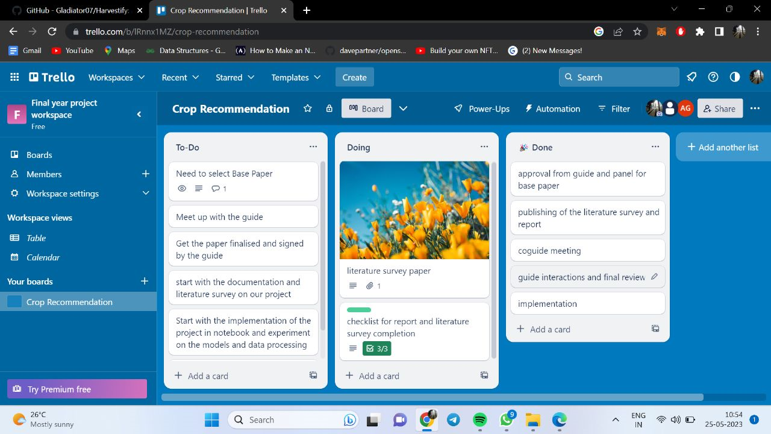
Implementation

Slide 12
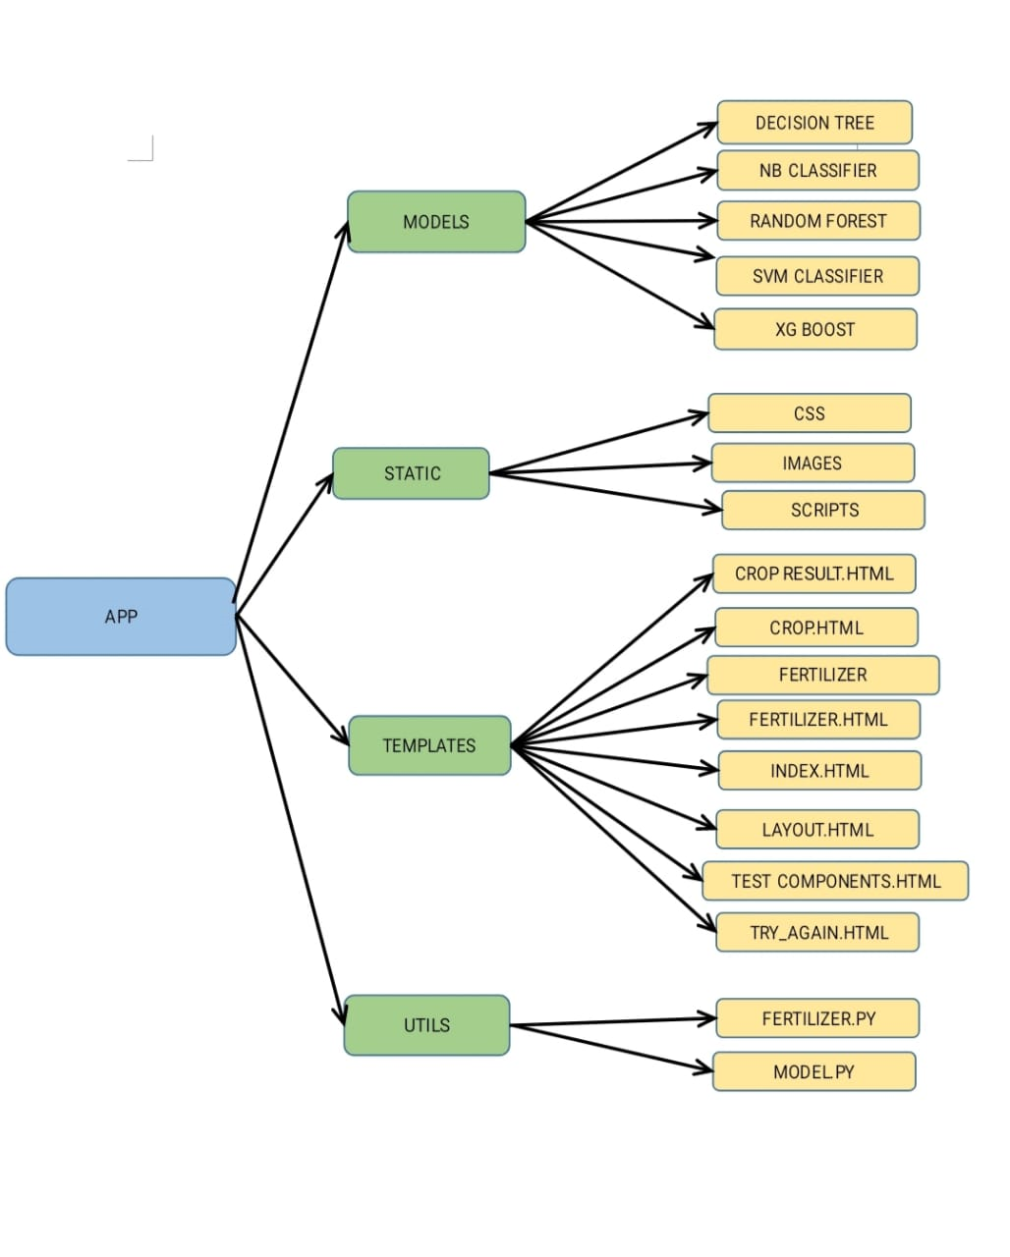
implementation

Slide 13
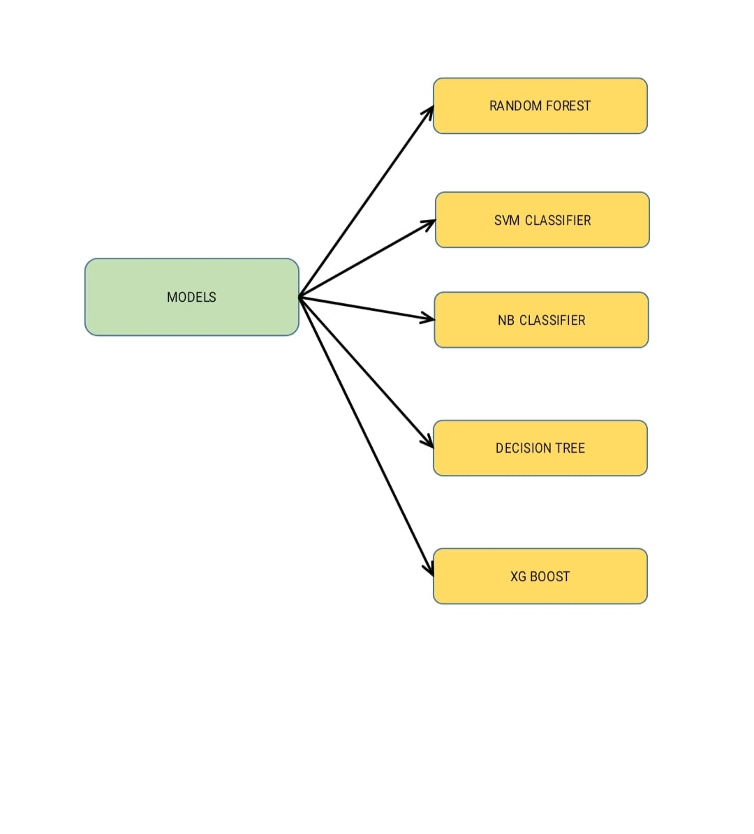
Implementation

Slide 14


Slide 15
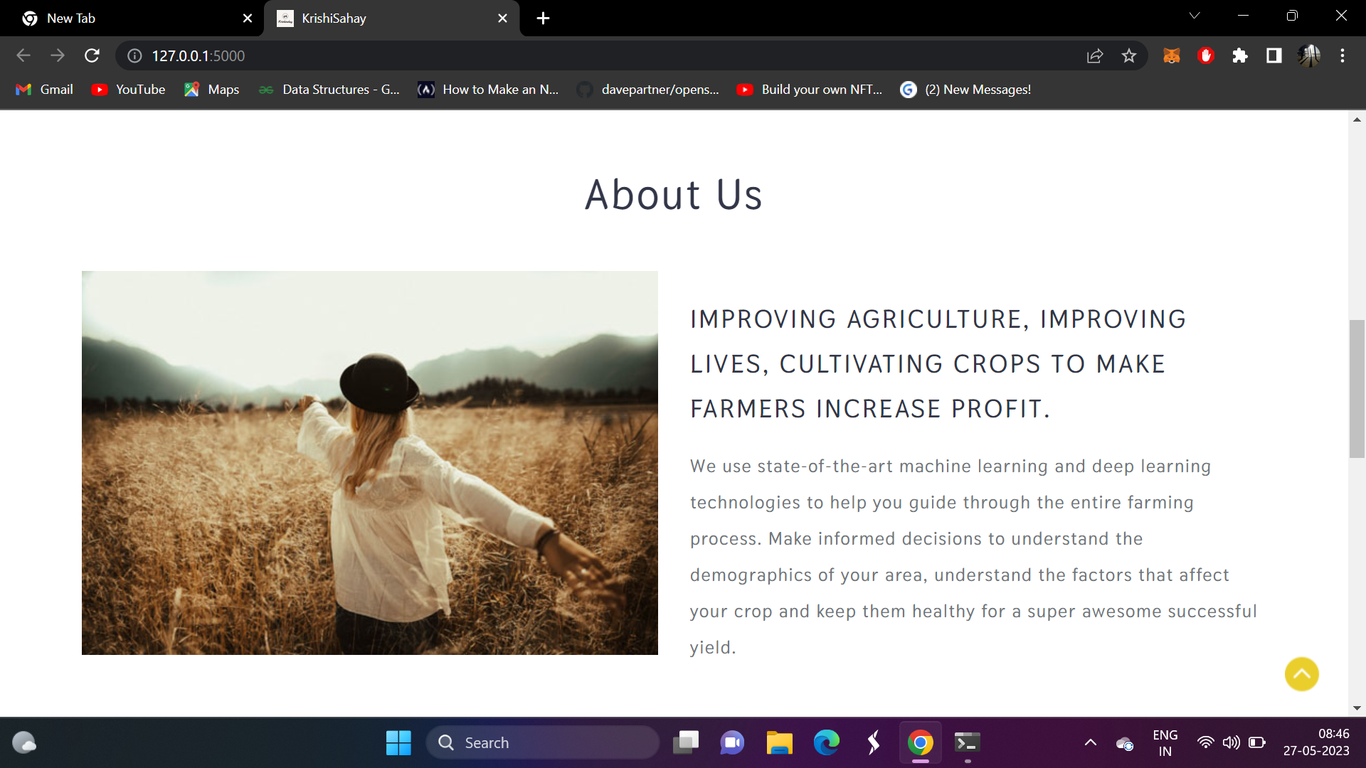

Slide 16
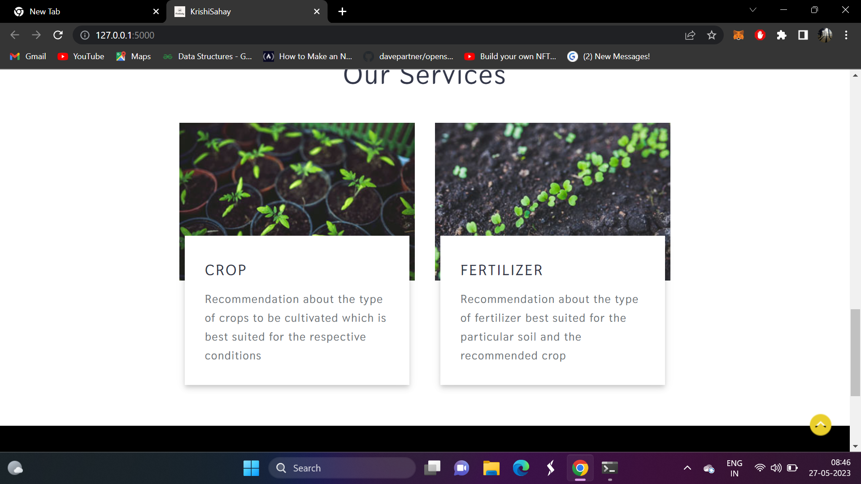

Slide 17
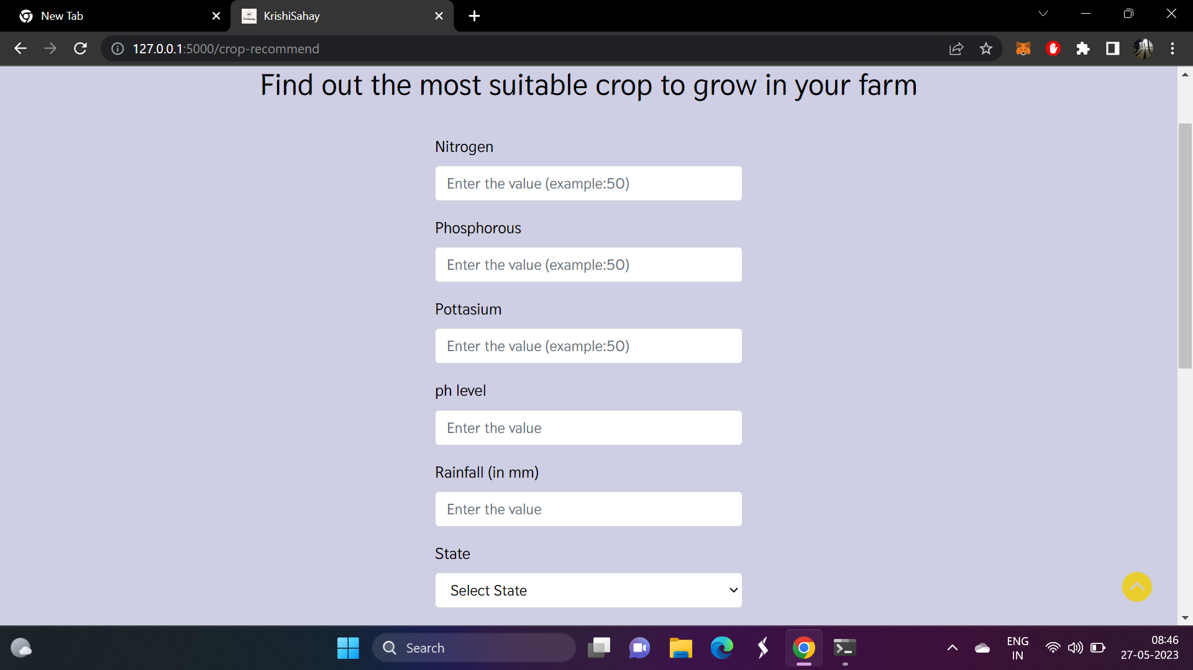

Slide 18
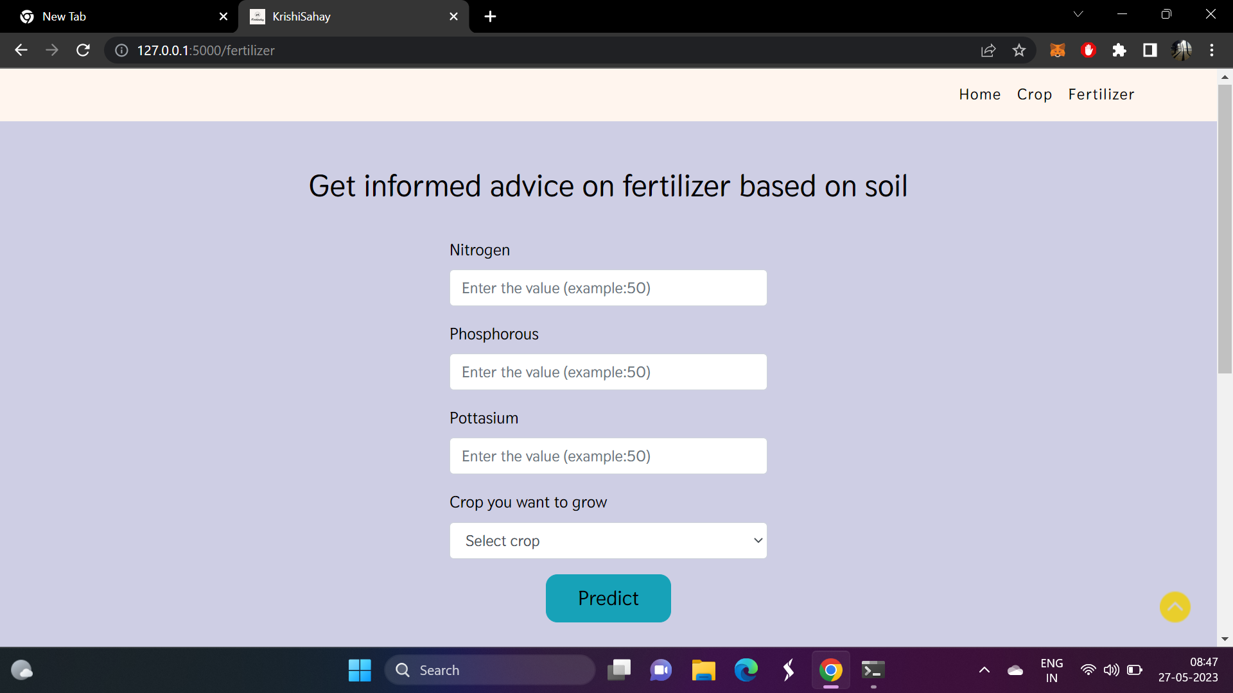

Slide 19
Conclusion
Agriculture is an important sector that plays an essential role in the economic development of a country. Each year farmers face numerous challenges in producing good quality crops. One of the major reasons behind the failure of the harvest is the use of unscientific agricultural practices.
Therefore we provide the machine learning models that could help every farmer to choose the best crop suitable based on soil composition and weather data.

Slide 20
THANK YOU

